Slide 1


IMPLEMENTATION OF ISO-GEOMETRIC ANALYSIS BASED TOPOLOGY OPTIMIZATION (IGTO).
Personal Programming Project WS 2020-21
Viswambhar Reddy Yasa
65074
Under the supervision of
Dr.-Ing. Martin Abendroth
29th April 2021

Slide 2
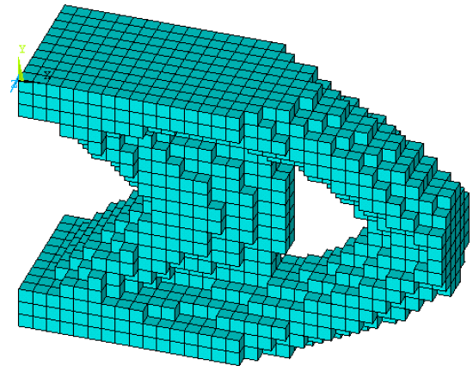
INTRODUCTION AND MOTIVATION
Topology optimization (TO) is a mathematical method that optimizes material layout within a given design space, for a given set of loads, boundary conditions and constraints with the goal of maximizing the performance of the system.^{[1]}
Finite element analysis is considered to be one of the most popular numerical methods which are used to find the approximate solution of partial differential equations.^{[2]}
Standard FEM utilizes the approximate form of the CAD geometries by discretizing them into a smaller sub-geometry called elements. This geometric approximation may lead to seriously affect the accuracy of the solution and lead to the various numerical errors during the analysis.^{[2]}
Iso-geometric analysis (IGA) is a computational approach that offers the possibility of integrating finite element analysis (FEA) and conventional NURBS-based CAD tool through which the described geometry can be directly used for analysis avoiding geometric approximations made in standard FEM.^{[2]}
In the case of optimization problems, a tight coupling between the design model and the analysis model is achieved as the design model is directly utilized in the analysis with IGA technique.^{[2]}
This approach will also save the geometry discretizing time and the results are checkerboard free but, not totally mesh independent and can change by using more discretization control points.^{[3]}

Slide 3

AIM AND TASKS OF THE PROJECT
AIM:
Application of the Isogeometric analysis (IGA) to perform topology optimization (TO) to achieve minimum compliance using method of moving asymptotes (MMA) and optimality criteria (OC).
TASKS:
Implementation of B-splines and NURBS based geometry.
Generate control point assembly and knot-connectivity for 3D structure.
Implementation of iso-geometric analysis for 3D structures.
Implementation of topology optimization using SIMP method.
Solving topology optimization problem using OC and MMA method.
Verification of optimized structure with literature results ^{[3]} for cantilever and simple supported beam.
Influence of parameters on topology optimization.
Time analysis is performed for all functions.

Slide 4
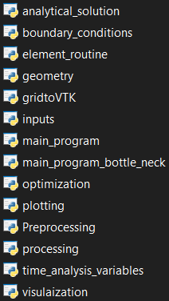
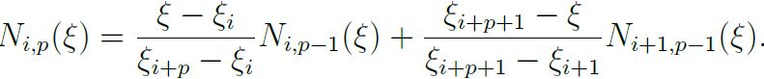
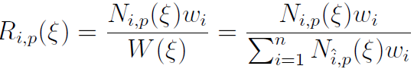
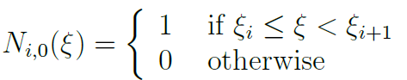
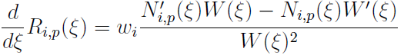
DETAILS ON THE MODEL AND CODE IMPLEMENTATION
IGA is built on Basis splines and requires parameter to define geometry.
In pre-processing, based on the inputs from user parameters like control points, knot vector, knot spans, knot connectivity are generated.
To perform IGA analysis, the following functions are built in geometry file.
Basis splines (B-splines) and Non-uniform rational Basis splines (NURBS)
Derivatives of B-splines and NURBS
Trivariant basis function and it’s derivatives
Control point assembly and knot connectivity matrix
List of python files
B-splines: Cox-de-Boor formulation
NURBS
Derivatives of B-spline and NURBS
def bspline_basis(knot_index,degree,U,knotvector):
def derbspline_basis(i,p,xi,XI,g=1):
Python functions in source code are mentioned in blue text

Slide 5
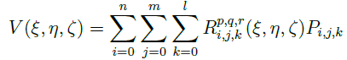
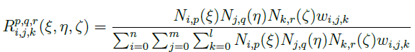
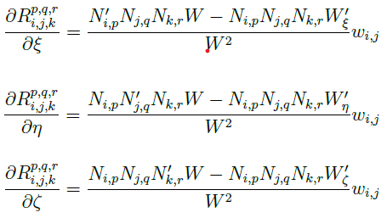
DETAILS ON THE MODEL AND CODE IMPLEMENTATION
To built a 3D structure in CAD, NURBS volume is used which requires trivariant function. Trivariant function is obtained from tensor product of NURBS along xi, eta, zeta direction.
To build Jacobian and strain-displacement matrices, derivatives of trivariant functions are required which is formulated from derivatives of B-spline and NURBS along xi, eta, zeta direction.
NURBS VOLUME
In IGA, discretization of global geometry into smaller patches is done using assembly array similar to connectivity array in FEM. The assembly array would require control points, knot vectors, NURBS weights.
The following function are generated to build assembly arrays.
Element order : A function which generates a 3D array containing the positions of the elements.
knot connectivity : An array which contains the length of each element expressed in the form of knot points.
Control point assembly : An array which contains the index of control points for each element built using element order and knot connectivity matrices.
TRIVARIANT FUNCTION
DERIVATIVES OF TRIVARIANT FUNCTION
def elementorder(numx,numy,numz):
def knot_connectivity(nx,ny,nz,knotconnectivityU,knotconnectivityV,knotconnectivityW):
def controlpointassembly(nx,..,nU,..,xdegree,…,knotconnectivityU,..):
def trilinear_der(Ux,Uy,Uz,weights,…,zdegree,zknotvector):

Slide 6
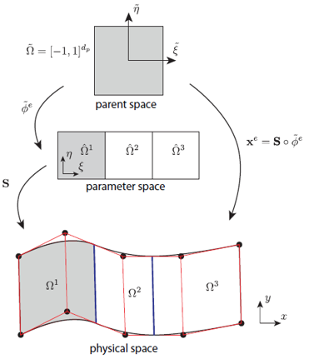
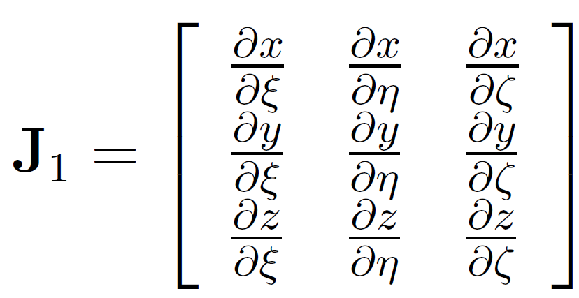
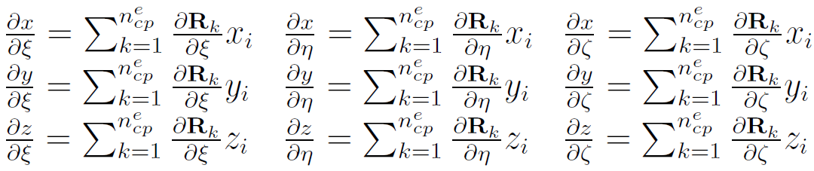
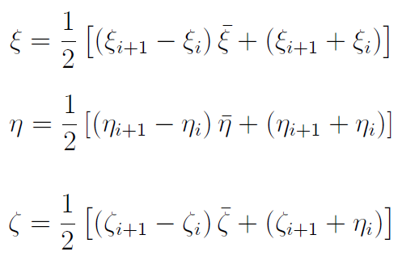
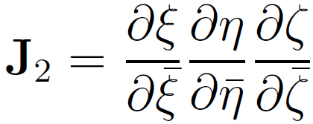
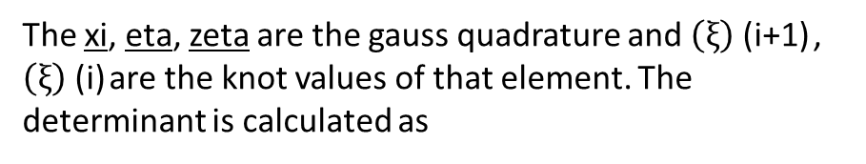
DETAILS ON THE MODEL AND CODE IMPLEMENTATION
In FEM, there are parent and physical spaces. The core concepts in IGA is outlining
the relevant spaces which are parent, parameter, physical.
Mapping of these relevant spaces is required to apply gauss quadrature.
1. Mapping from physical space to parameter space (Jacobian1)
2. Mapping from parameter space to parent space (Jacobian 2)
The xi, eta, zeta are the gauss quadrature and $\left(ξ\right)$ (i+1) , $\left(ξ\right)$ (i) are the knot values of that element. The determinant is calculated as
Det
def jacobian(Xi,Eta,Nta,Uspan,Vspan,Wspan,X,Y,Z,weights,xdegree,xknot_vector,ydegree,yknot_vector,zdegree,zknot_vector):

Slide 7
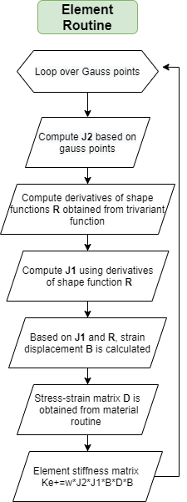
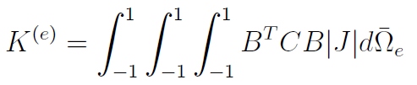
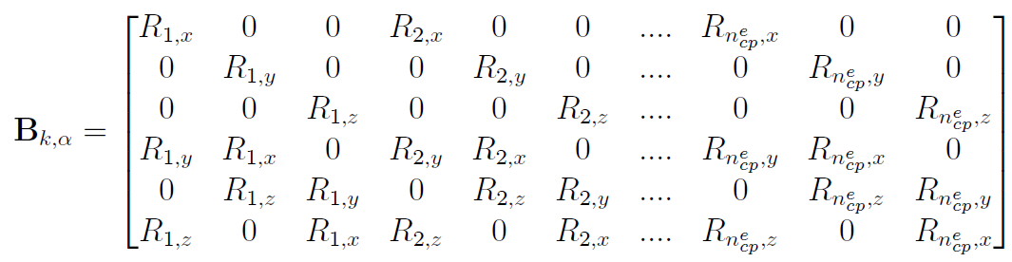
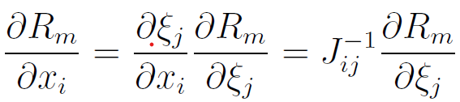
DETAILS ON THE MODEL AND CODE IMPLEMENTATION
Element stiffness matrix formulation is given below, where J=J1*J2
The Strain-displacement matrix B is a function of derivatives in global co-ordinates and gauss quadrature can be applied only in normalized co-ordinate system. The below relation transform normalized derivatives to co-ordinate derivatives using Jacobian1.
Rm,j are the derivatives of trivariant basis functions
To perform element routine the following python function are built.
Gauss quadrature, 2) Jacobian, 3) strain displacement, 4) Compliance matrix,
5) element routine.
def gauss_quadrature(p,q,r):
def Compliance_matrix(E=100000,v=0.3):
def element_routine(X,Y,Z,weights,E,v,Uspan,…,,xdegree,xknot_vector,….,zdegree,zknot_vector):
def strain_displacement(Xi,Eta,Neta,jacobian1,det_jacobian1,DR_DXi,nurbs,nn):

Slide 8
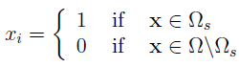
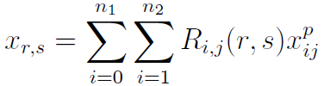
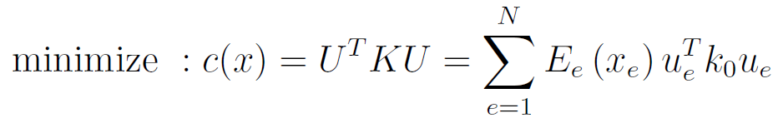
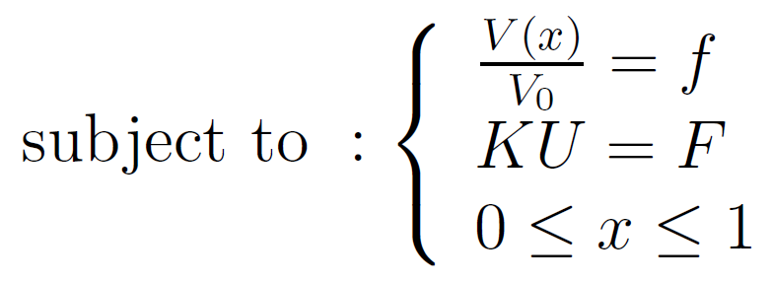
DETAILS ON THE MODEL AND CODE IMPLEMENTATION
Topology optimization can be described as binary compliance problem which is use to find a "black and white" layout that minimizes the compliance subjected to volume constrain. We implement density-based approach known as Solid Isotropic Material with Penalization (SIMP) a penalization method.
Where element density is
IN IGA, the element densities are approximated by the NURBS basis functions over a
patch which enable us to have close association of geometry with element density.
where E0 is the elastic modulus of material, Emin is the minimum elastic modulus of the void region which prevents stiffness matrix singularity. P is the penalization factor introduced to ensure black and white layout. R are the trivariant basis function and x{ij} are the nodal densities.
The mathematical formulation of the optimization problem reads as follows:
Where C is compliance, k0 is the element stiffness matrix, N number of elements, V(x) and V0 are the material volume and design volume. f is the prescribed volume fraction.

Slide 9
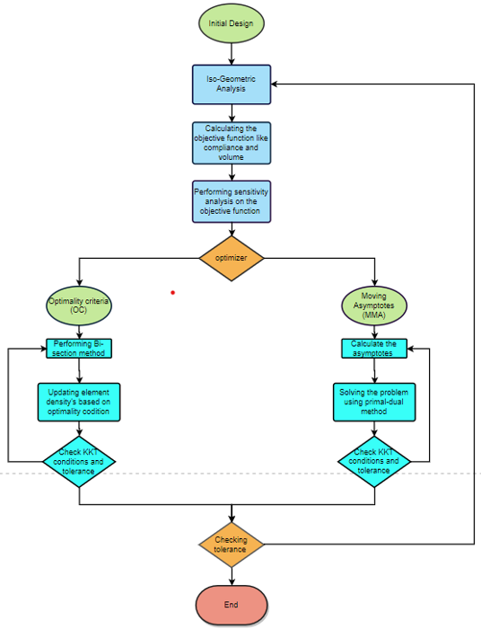
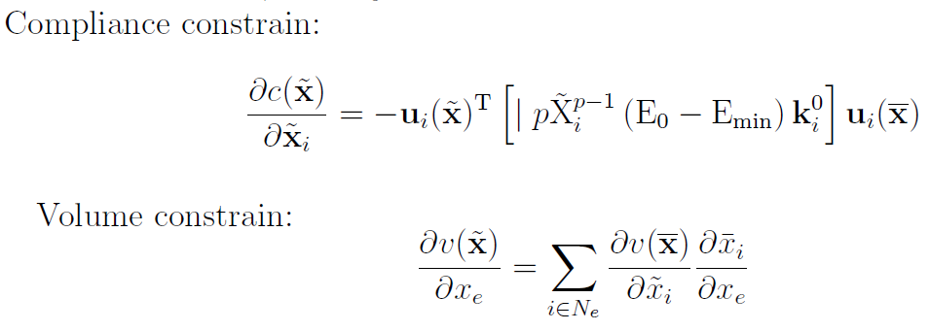
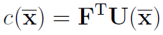
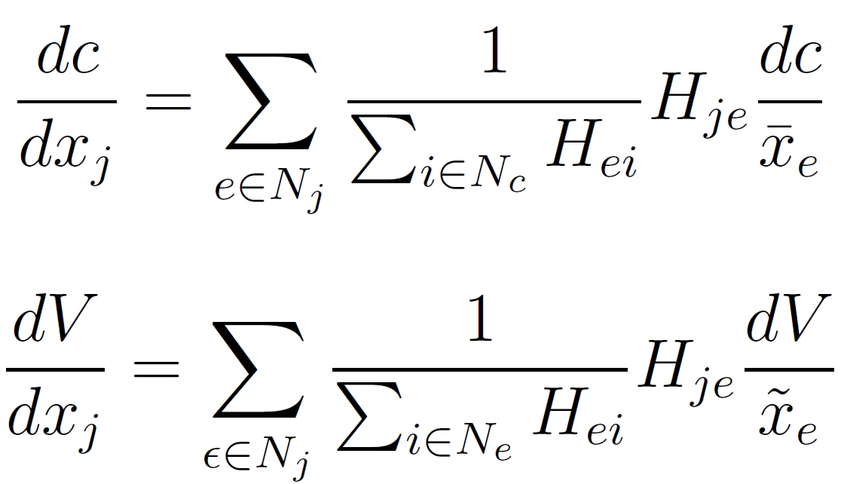
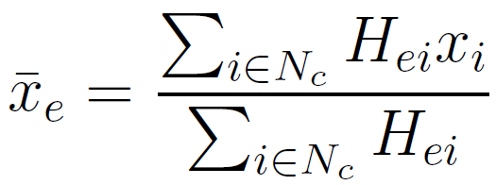
DETAILS ON THE MODEL AND CODE IMPLEMENTATION
Using minimum compliance formulation, the constrains are evaluated.
Compliance function:
SENSITIVITY ANALYSIS
To ensure that topology optimization problem would exist and avoid the formation of checker board pattern or pores in the design. We applying filter or sensitivity to objective function like compliance and volume constrains.
Basic filter function is defined as:
where Hei, Hje is the weight factors which depends on rmin
def Knearestneighbours(rmin,nelx,nely,nelz):
From the obtained objective function and constrains We utilize optimization
algorithm like OC and MMA to achieve minimization .

Slide 10
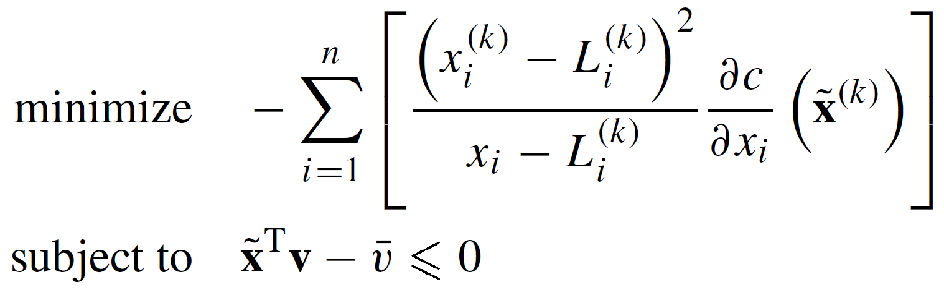
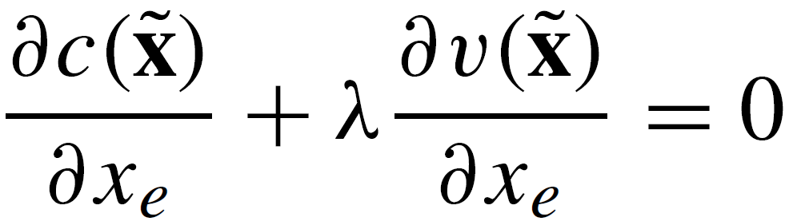
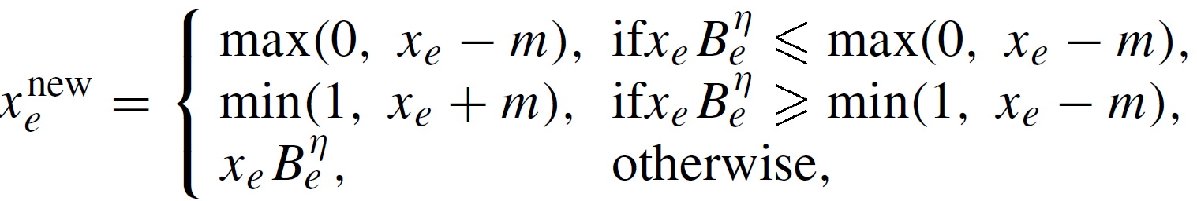
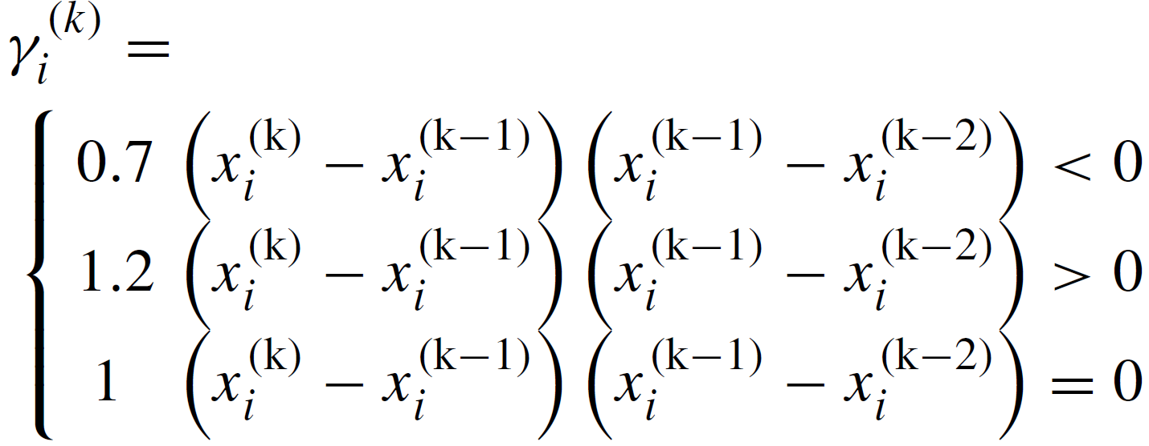
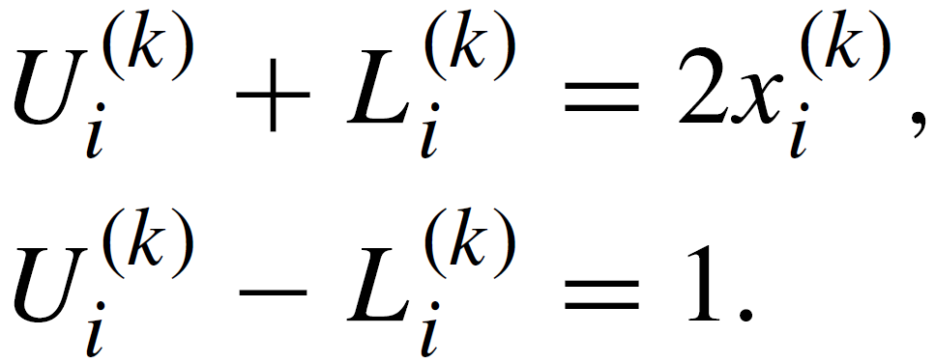
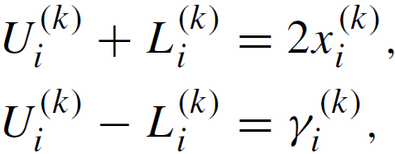
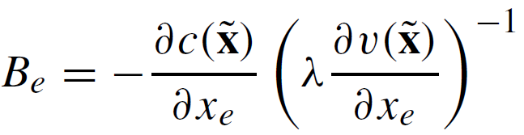
DETAILS ON THE MODEL AND CODE IMPLEMENTATION
OPTIMIZATION ALGORITHM FORMULATION
Optimality criteria (OC)
Method of Moving Asymptotes (MMA)
This is a penalty based method where weights are added to Lagrangian multiplier. Optimization can be achieved if KKT condition converge given below.
Moving Asymptotes is a gradient based optimization algorithm
Find x
The implementation of OC update scheme is given below:
The lower and upper asymptotes L(k) and U(k) are iteratively updated to mitigate oscillation or improve convergence rate.
For K<3
For K>=3
The Lagrangian multipliers obtained by root finding algorithm such as bi-section method.
MMA is solved using Prime-dual method which is part of active set strategy. Prime-dual method is gradient based method and uses Newton Raphson to solve KKT conditions.
where m is move limit and ἠ is numerical damping coefficient and optimality condition Be
def Moving_asymptoes(dfun0,dcon,f0,c0,x0,x1,x2,L,U,loop,nel,vel,Xmin,Xmax,..)
def optimality_criteria(dfun,dCon,initial_X,constrain,residual=None,H=None,DH=None,…)

Slide 11
DETAILS ON THE MODEL AND CODE IMPLEMENTATION
Post-processing:
Mapping displacements:
[New control points] = [Control points] + [U]
Mapping Strains and Stresses: In Iso-geometric analysis, the strains and stresses are interpolated at the gauss
points because of this the mapping requires a complex procedure which depends on the size of each knot vector and span of knot vector.
def stress_strain_element_routine(X,Y,Z,weights,displacements,E,v,Uspan,xdegree,xknot_vector,zdegree,zknot_vector):
Mapping element densities: The element density xi is an array and based on the element number obtained from element order. The element density array is mapped into 3D array which is saved as a text file.
Visualization of topology
VTK(Visualization Tool-kit) : VTK is a open source library used for scientific visualization. This tool can be used
to plot topology optimization which is based on volume analysis. To generate VTK file, we used PYEVTK python library. This VTK file can be used for visualization in Paraview or Blender.
def VTK(CONTROL_POINTS,element_density,nx,ny,nz,file_name):
PYVISTA : A open-source python library used for scientific visualization. It can be used to plot VTK file without the need of external visualization tool(Paraview). Pyvista used GUI to plot 3D structure which is built on top of VTK library.
def mesh_vis(CP,U,nx,ny,nz,optimizer):
def element_density_slided1(i,CP,nx,ny,nz,element_density,optimizer):

Slide 12
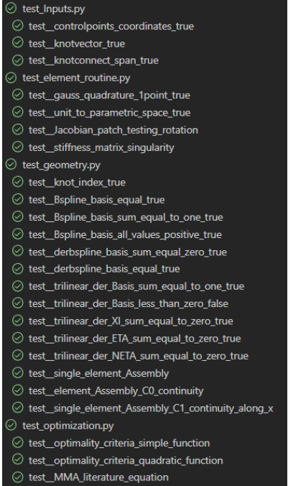
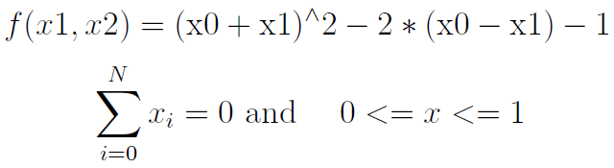
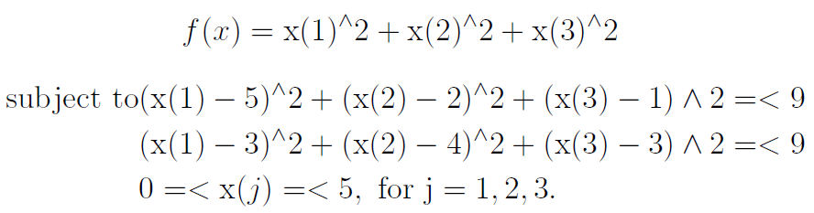
DETAILS ON THE TESTS
Imported library: PYTEST
Unit testing is performed to detect any error in the code. We have perform functional unit testing i.e. each function is test with expected values.
test_Inputs.py : Test cases for input parameters
test_geometry.py : Test cases on shape function and assembly
test_element_routine.py : Test cases on integration scheme and sanity checks on other element routine functions.
Functional testing is performed on optimization algorithms like OC and MMA. Where the optimal minima has to be obtained for the given set of KKT conditions.
4. test_optimization.py : Test cases to check optimization algorithms.
OC is used to solve a quadratic problem with following constrains
MMA is used to solve a quadratic problem with following constrains
Expected output:[0.5, 0.5]
List of test cases
Expected output: [2.0175, 1.7800, 1.237]

Slide 13
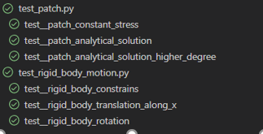
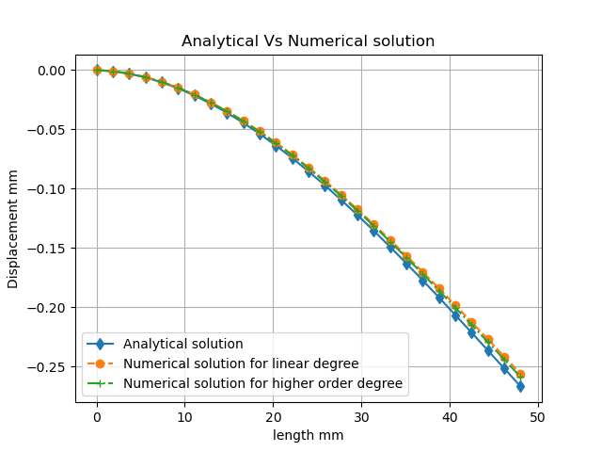
DETAILS ON THE TESTS
The validation of IGA is done using some standard tests like patch testing and rigid body rotation. The following test are carried out to validate global stiffness matrix.
Eigenvalue stiffness test:
Global stiffness matrix should be positive definite : eigen values of global stiffness matrix should be non-negative.
The number of eigen values which are zeros represents the rigid body motion of global stiffness matrix. (Boundary conditions are also checked)
unconstrained - 6 zeros eigenvalues (3-rotation, 3-translation)
constrained – No zero eigenvalues
List of test cases
2. Rigid body translation and rotation tests: This tests validates whether global stiffness matrix is able to represent rigid body motion. In this tests, we apply displacement boundary condition on all exterior nodes and calculate the residual forces. From the residual forces , the interior node displacements are calculated.
Patch test : To validate if our FEM would converged. Single element constant stress or strain patch test is carried out
Validation of Iso-Geometric Analysis :Analytical solution of cantilever beam with point load at free end is use to validate the displacements along the bottom end obtained from numerical analysis. The test is carried out for linear and higher degree of knot vector.

Slide 14
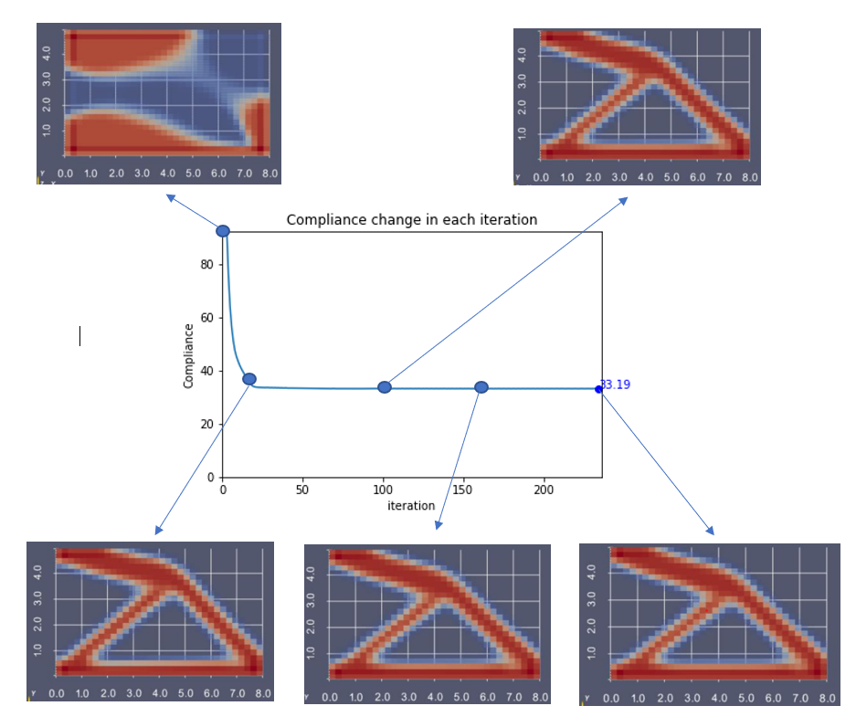
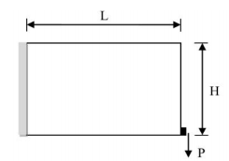
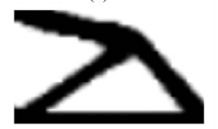
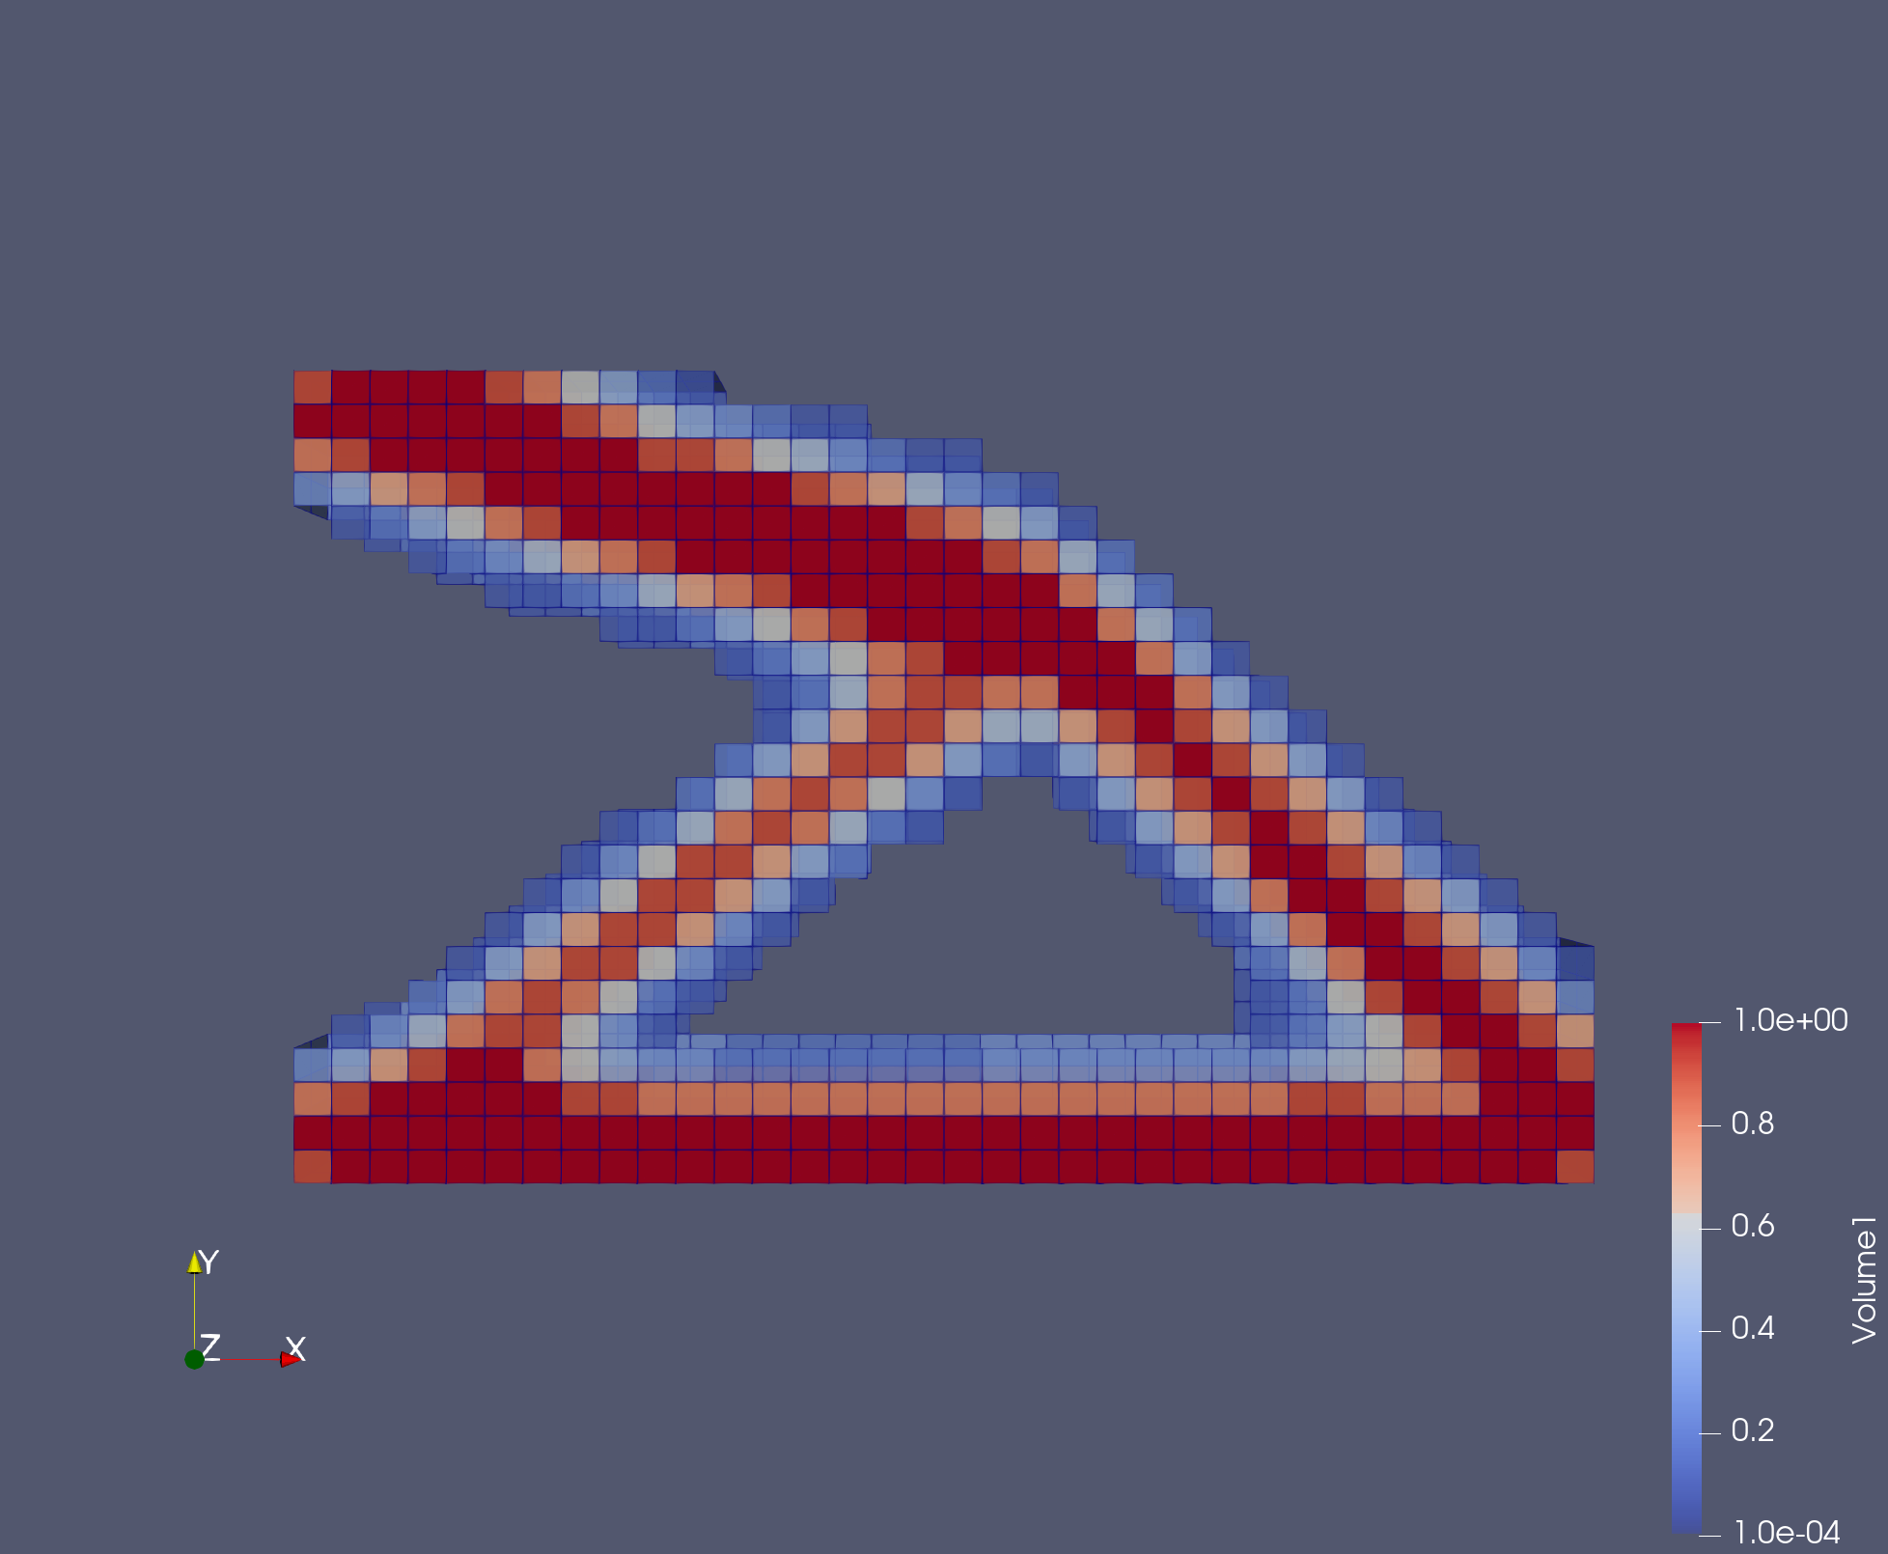
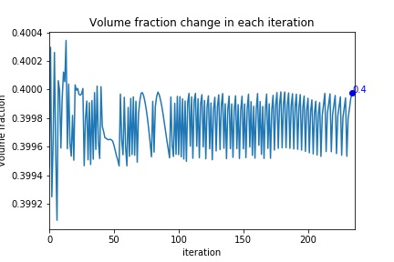
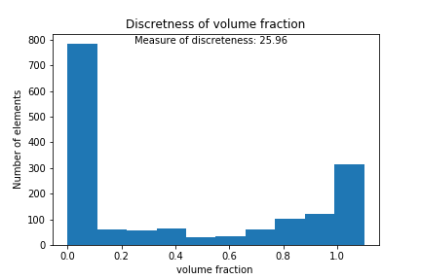
RESULTS AND DISCUSSION
TOPOLOGY OPTIMIZATION USING OC
Problem statements : 1
Cantilever beam
Analytical solution from literature[3].
Numerical solution plotted in Paraview

Slide 15
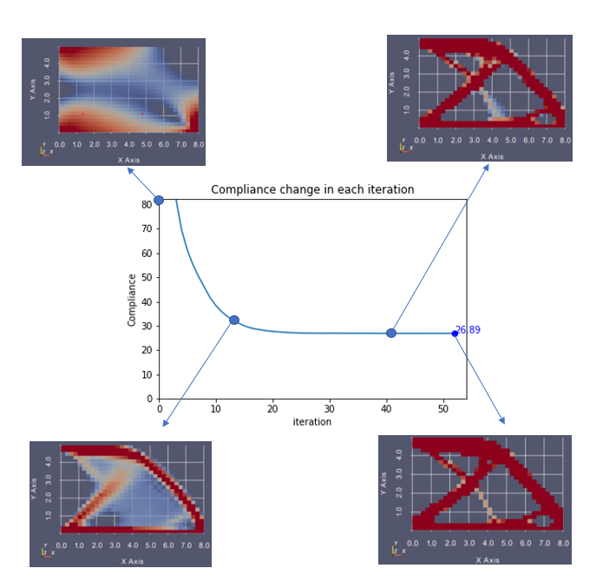
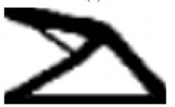
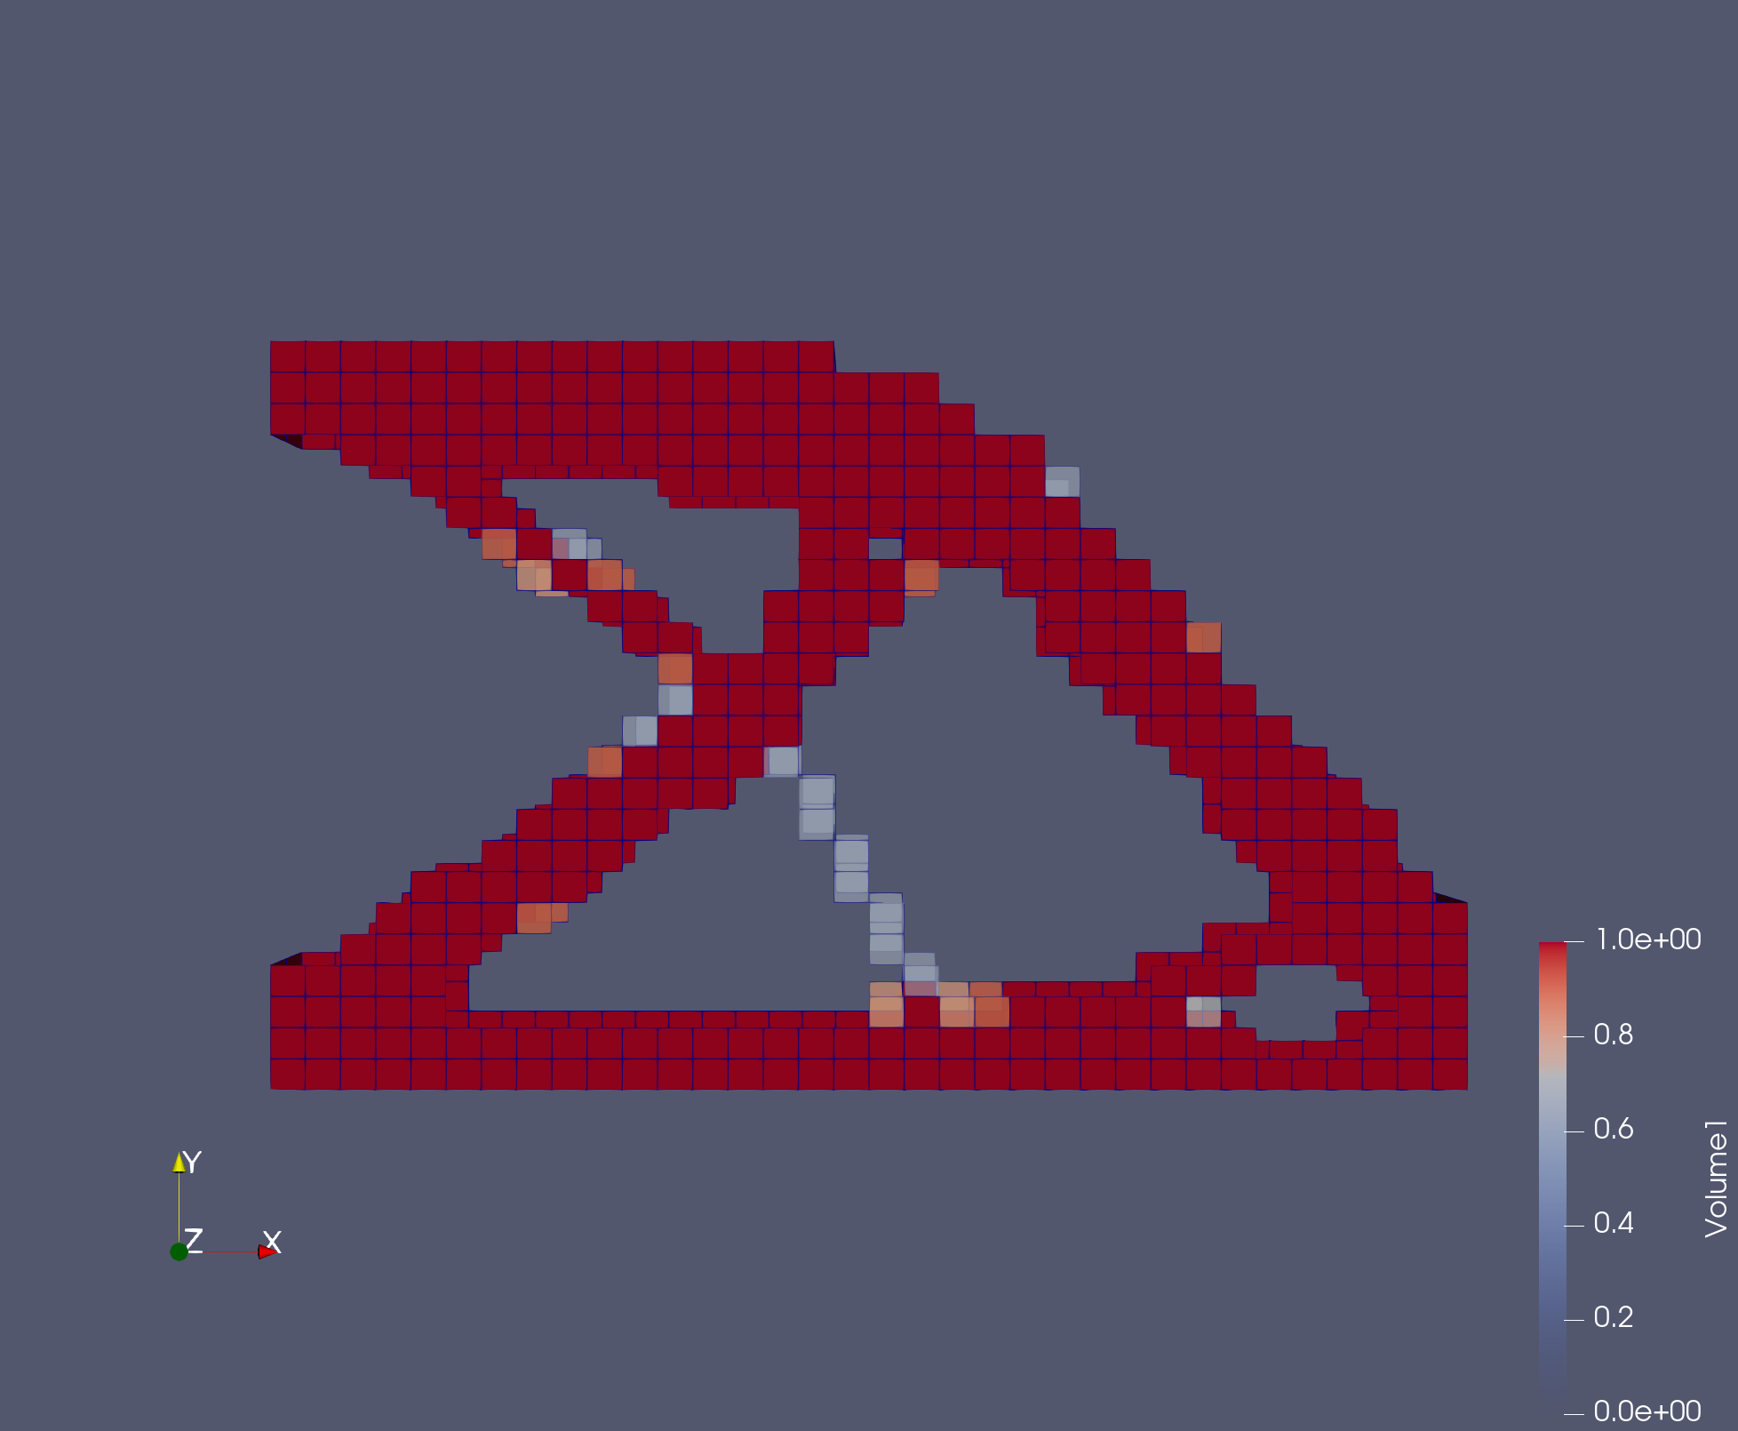
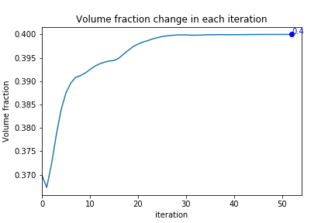

RESULTS AND DISCUSSION
TOPOLOGY OPTIMIZATION USING MMA
Problem statements : 1
Cantilever beam
Analytical solution from literature[3].
Numerical solution plotted in Paraview

Slide 16






RESULTS AND DISCUSSION
TOPOLOGY OPTIMIZATION USING OC
Problem statements : 2
Cantilever beam
Analytical solution from literature[3].
Numerical solution plotted in Paraview

Slide 17




RESULTS AND DISCUSSION
TOPOLOGY OPTIMIZATION USING MMA
Problem statements : 2
Cantilever beam
Analytical solution from literature[3].
Numerical solution plotted in Paraview

Slide 18






RESULTS AND DISCUSSION
TOPOLOGY OPTIMIZATION USING MMA
Problem statements : 3
Simple supported beam
Analytical solution from literature[3].
Numerical solution plotted in Paraview

Slide 19





RESULTS AND DISCUSSION
TOPOLOGY OPTIMIZATION USING MMA
Problem statements : 3
Simple supported beam
Analytical solution from literature[6].
Numerical solution plotted using pyvista

Slide 20








RESULTS AND DISCUSSION
Influence of parameters on topology optimization
For problem statement 1
1. Penalization factor {P} : Penalization factor is used to remove porosity with in material so checker board pattern can be avoided.
P=5
P=10
P=20
P=30

Slide 21








RESULTS AND DISCUSSION
Influence of parameters on topology optimization
For problem statement 1
2. Minimum Radius {rmin}:rmin is the minimum distance between the neighboring elements which is used as a parameter in sensitivity analysis to build weight factor.
rmin=2
rmin=5
rmin=10
rmin=30

Slide 22

TIME ANALYSIS: BOTTLE-NECK IN CODE
main_program_bottle_neck.py implements time analysis.
Imported library: time
A log file is generated with contains the number of times the function was called, total time taken by the function and average time taken by the function. A separate log file is created for each optimizer. The log file also lists the top 5 functions with high execution time.
LOG FILE DATA:
AUTHOR : YASA VISWAMBHAR REDDY
!# 1616605044.207525 Topology Optimization using Iso-Geometric Analysis MMA
Total execution time of the whole program: 1363.7347421646118 sec
--------- initial condition ---------
Total Number of time " initial condition " was called 53 times.
Average time taken by the " initial condition " function during one run 7.528179096725751e-05 seconds.
Total time taken by the " initial condition " function 0.0039899349212646484 seconds.
--------- strain displacement ---------
Total Number of time " strain displacement " was called 1396992 times.
Average time taken by the " strain displacement " function during one run 4.5424312235716175e-05 seconds.
Total time taken by the " strain displacement " function 63.45740079879761 seconds.
--------- unittoparametric ---------
Total Number of time " unittoparametric " was called 4190976 times.
Average time taken by the " unittoparametric " function during one run 3.492859296924389e-06 seconds.
Total time taken by the " unittoparametric " function 14.638489484786987 seconds.
--------- Compliance matrix ---------
Total Number of time " Compliance matrix " was called 174624 times.
Average time taken by the " Compliance matrix " function during one run 3.2285849253336587e-06 seconds.
Total time taken by the " Compliance matrix " function 0.5637884140014648 seconds.
cantilever beam
Time analysis pie chart based on function calls

Slide 23
SUMMARY
In this project, structural topology optimization is performed on 3D structures. An Iso-geometric code based on NURBS volume is generated for parametric details. The advantage of NURBS over Lagrangian basis function is NURBS can correctly interpret geometry as it doesn't approximate it which allows us to build
complex optimized structure which have less compliance.
Lower compliance is achieved using MMA and the number of iterations required to achieve optimized structure are less using MMA than OC method.
MMA would converge faster and has less discrete volume.
The measure of discreteness for MMA and OC methods shows that MMA penalizes the element volume effectively than OC method.
From volume fraction change at each iteration for MMA and OC methods. As MMA is gradient based method it approaches the final volume gradually where as OC is penalty based method therefore fluctuates about the volume constraint.
The topology optimization depends mainly on penalization factor {P} and minimum radius {rmin}. Topology optimization also depends on the type of optimizer being used like OC and MMA.
The convergence to optimal solution using OC method is not efficient which can be improved by using filters.

Slide 24
REFERENCES
Kingman & Tsavdaridis, Konstantinos & Toropov, Vassili. (2014). Applications of Topology Optimization in Structural Engineering.
Agrawal, Vishal, and Sachin S. Gautam. "IGA: A simplified introduction and implementation details for finite element users." Journal of The Institution of Engineers (India): Series C 100.3 (2019): 561-585.
Tavakkoli, Mehdi & Hassani, Behrooz & Ghasemnejad, Hossein. (2013). Isogeometric topology optimization of structures by using MMA. INTERNATIONAL JOURNAL OF OPTIMIZATION IN CIVIL ENGINEERING. 3.
Liu, Hongliang & Yang, Dixiong & Hao, Peng & Zhu, Xuefeng. (2018). Isogeometric analysis based topology optimization design with global stress constraint. Computer Methods in Applied Mechanics and Engineering. 342. 10.1016/j.cma.2018.08.013.
R. L. Taylor, J. C. Simo, O. C. Zienkiewicz, and A. C. H. Chan, The patch test a condition for assessing fem convergence," International Journal for Numerical Methods in Engineering, vol. 22, no. 1, pp. 39{62, 1986.
K. Liu and A. Tovar, An efficient 3d topology optimization code written in MATLAB," Structural and Multidisciplinary Optimization, vol. 50, 12 2014

Slide 25
THANK YOU

